Slide 1
Systolic Array GEMM Accelerator on the Arty A7 FPGA
The Dot Product Team
Maasil Wani (Lead), Linda Mendez, Wayne Hsieh, Tyler Lee, Niels van Ritbergen, Daniel Arnold

Slide 2
Content
Introduction and Background.
Problem Statement.
Proposed approach.
Project Overview
How does a systolic array work?
Systolic Array Timing
Systolic Array RTL Simulation
Systolic Array FPGA Testing
PE Controller
PE Controller FSM Structure and Operation
BRAM, MicroBlaze, PE Controller FSM Interface
PE Controller Testing and Verification
Integration with Microblaze.
Block View from Vivado and Memory Mappings.
Performance Evaluation
Discussion and Improvements
Recorded Demo

Slide 3
Introduction and Background
The Problem: The Memory Wall
Modern workloads (Neural Networks, DSP) are bottlenecked by data transfer, not compute speed.
General-purpose processors waste clock cycles waiting for memory because they read the same matrix elements multiple times.
Existing Solutions / limitations
Software Tiling: Requires heavy manual optimization by the programmer
SIMD (Vector Processing): large matrices still exceed cache limits and force slow memory reads.

Slide 4
Problem Statement
Our design will address the Von Neumann bottleneck, which refers to the use of single bus to process both instruction and data operations. This bottleneck results in high power consumption and many idle cycles.
We are creating an embedded hardware accelerator that minimizes memory bandwidth through data reuse.

Slide 5
Proposed approach
Systolic array for matrix multiplication
Divided into three teams
Team 1: Systolic Array
Implementing processing elements, and the data skewing / alignment logic
Team 2: PE controller
This team handles the control path, memory addressing, and data orchestration.
Team 3: Microblaze and Vivado Integration
Handles the overall integration of the Accelerator with the Microblaze System

Slide 6
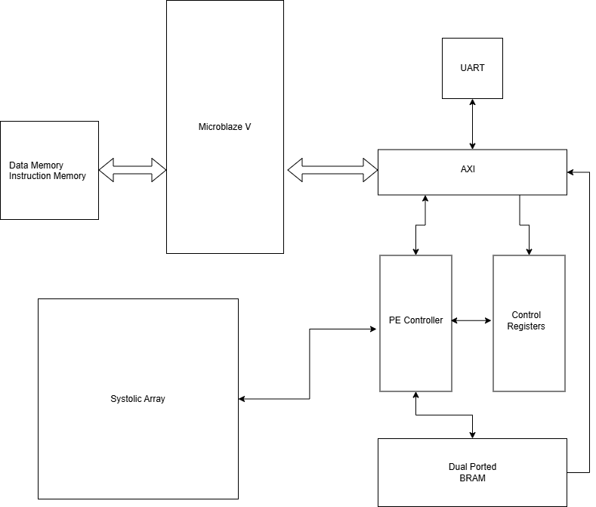
Project Overview
Processor sends data to Dual Ported BRAM via AXI interface
Processor Configures the Control Registers
PE control observes the values of control registers and sends data from Dual Ported BRAM to systolic Array, and copies result back to BRAM
After Computation PE controller sets the control registers indicating result is present in Dual Ported BRAM for CPU to use

Slide 7
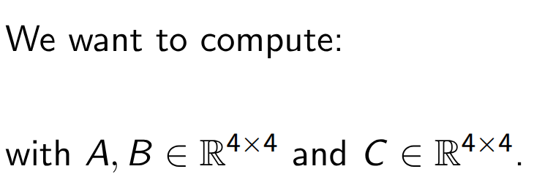

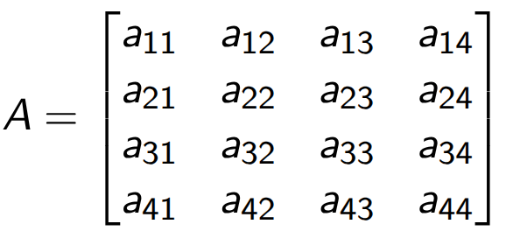
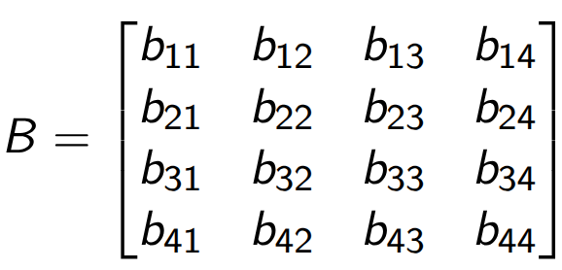
How does a systolic array work?

Slide 8
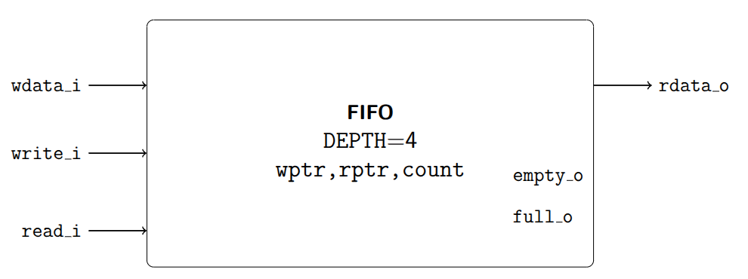

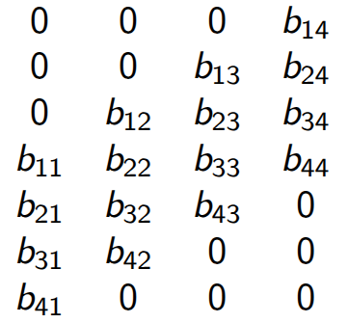

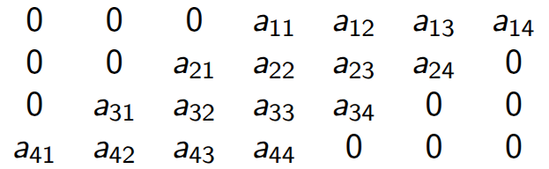
Writing the data
We start by adding some skew in A and B using FIFOs.
FIFO DEPTH=4
FIFO DEPTH=4
FIFO DEPTH=4
Systolic Array Module
FIFO DEPTH=4

Slide 9
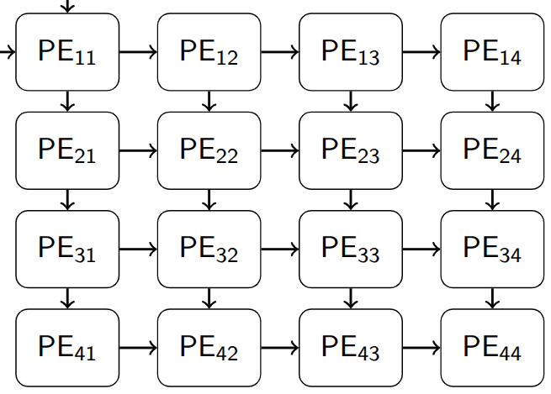
PE array
B rows
PE:
bin
ain
aout
A
columns
x
+
bout
acc
Each PE performs: p <- p + a*b

Slide 10
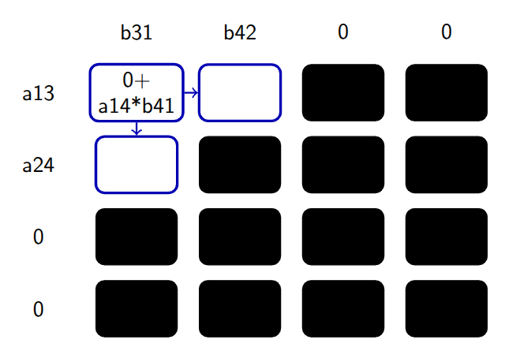
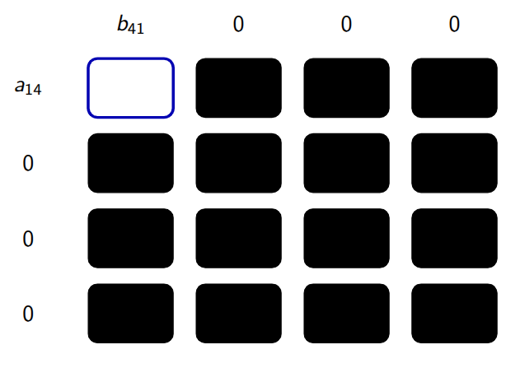
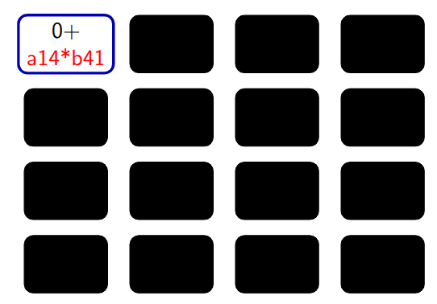
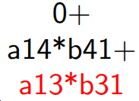



The computing cycles
Cycle 1
Cycle 2
a41
b14
…
Cycle 4
Cycle 10
c11
PE12
PE13
PE14
c11
c12
c13
c14
PE21
PE22
PE23
…
c21
c22
c23
c24
PE31
PE32
c31
c32
c33
c34
PE41
c41
c42
c43
c44
First output value is ready

Slide 11
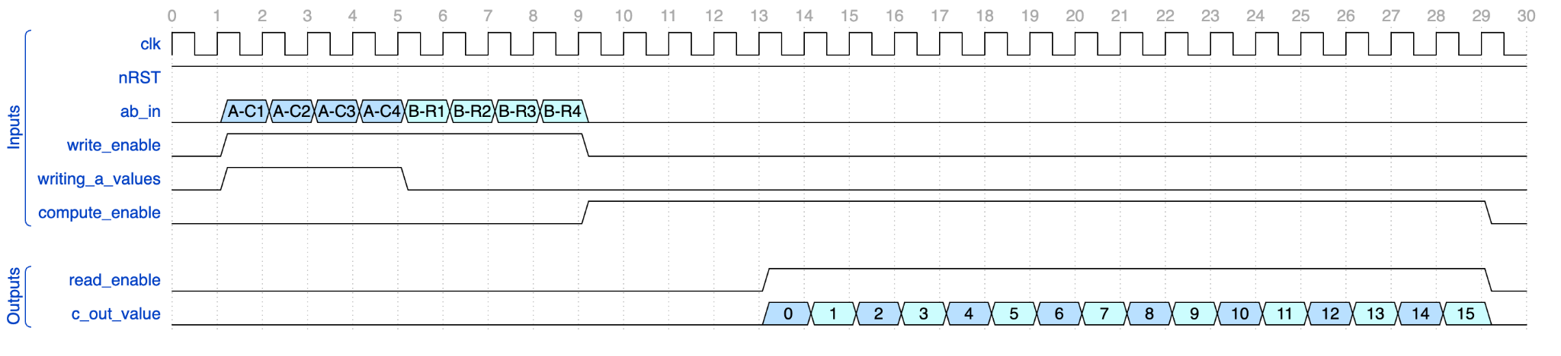
Systolic Array Timing
4 cycles: The array receives the columns of matrix A.
4 cycles: The array receives the rows of matrix B.
10 computing cycles. In the cycle 4 we obtain first output value.
6 + 10 output cycles. 6 happen while computing
Output Values

Slide 12
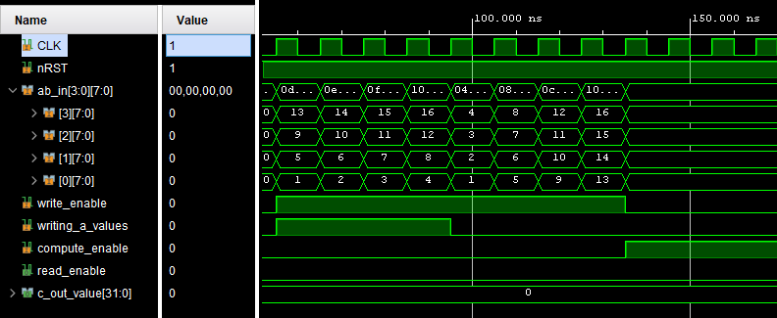
Systolic Array RTL Simulation - Load Data
A
B

Slide 13
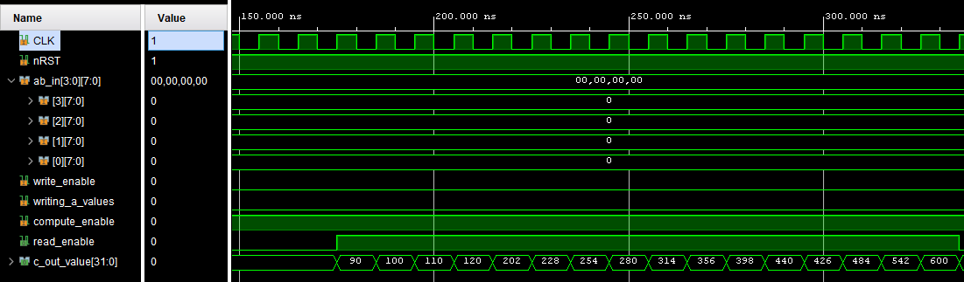
Systolic Array RTL Simulation - Return Data
C output matrix

Slide 14
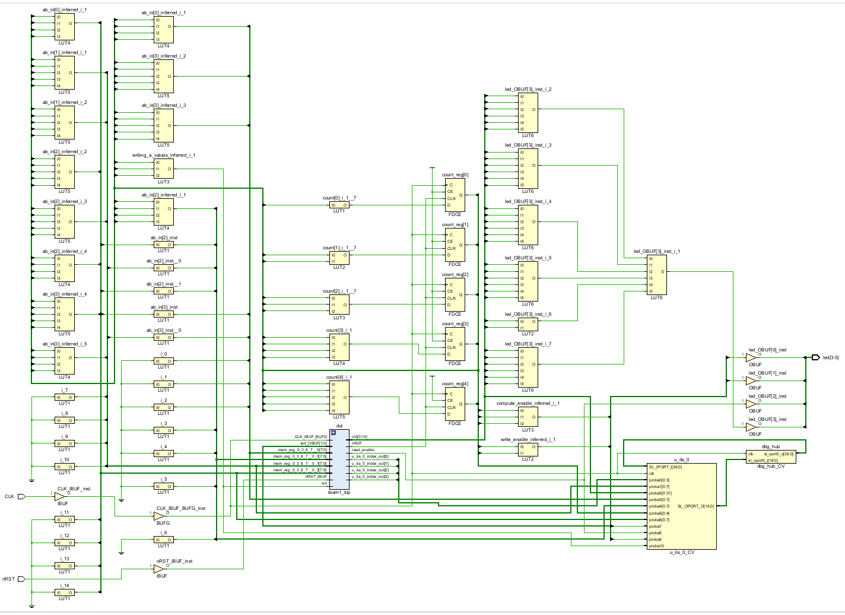
Systolic Array FPGA Testing
Systolic Array
ILA for debug
and waveform viewing
FPGA Wrapper

Slide 15
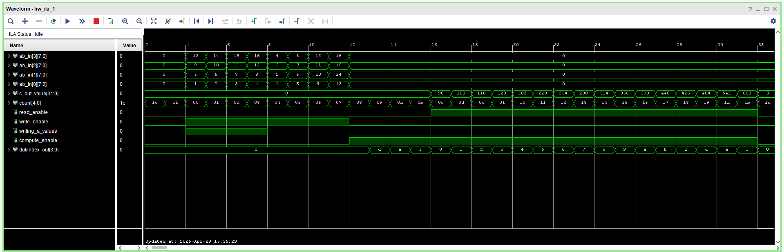
Systolic Array FPGA ILA Waveform

Slide 16
PE Controller
Interface between Microblaze and Systolic Array
Read/Write
Block Memory (BRAM)
Top Level Data Interface
Controller FSM
MicroBlaze RISC Communication
Systolic Array Communication
Matrix and Control Signals pass through

Slide 17
PE Controller FSM Structure and Operation
Primary Objective: facilitate cycle-accurate data flow between system memory and the 4x4 systolic array.
Synchronized Input Streaming: Sequentially loads operand Matrices A and B over 8 discrete clock cycles (4 cycles per matrix).
Deterministic Output Capture: Monitors the array's read flags to capture and route all 16 cycles of computed output back to memory.

Slide 18
BRAM, MicroBlaze, PE Controller FSM Interface
 | Read/Receive by PE Controller | Write/Send to Target
PE Controller to BRAM | Matrix A values Matrix B values | Multiplied Matrix Values
PE Controller to Microblaze | Matrix A address Matrix B address Controls and Triggers | Multiplied Matrix address Triggers
PE Controller to FSM (Internal) | Pass up Multiplied Matrix values (from systolic array) | Pass down Matrix A values Pass down Matrix B values (to systolic array)

Slide 19
Integration with Microblaze
Microblaze V running on Arty A7 at 100Mhz
Local Memory DMEM/IMEM 16KB Connected to Processor via LMB interface
AXI Interconnect routing to three peripherals, Controller, Control Registers and the Dual Ported BRAM
Control Registers exposing Handshake and matrix addresses to the PE Controller
Dual Port 16KB DMEM shared between the accelerator and CPU
PE Controller for managing execution

Slide 20
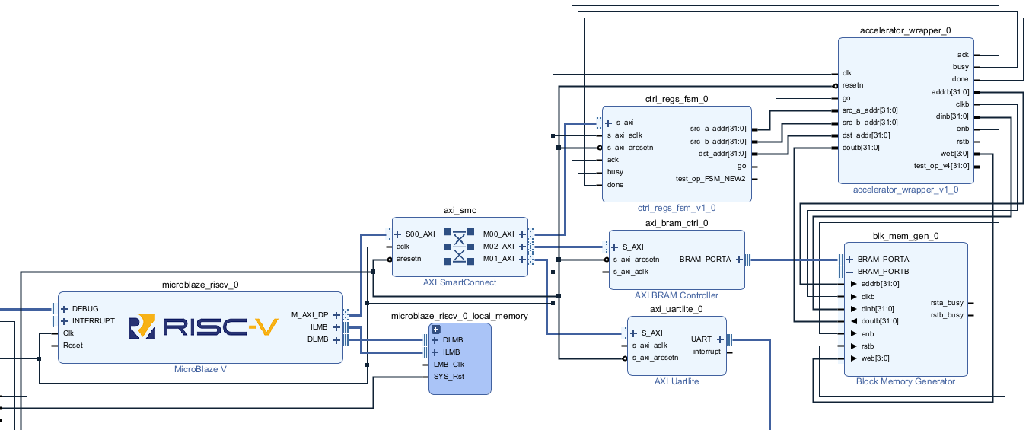
Block View From VIVADO and Memory Mappings

Slide 21
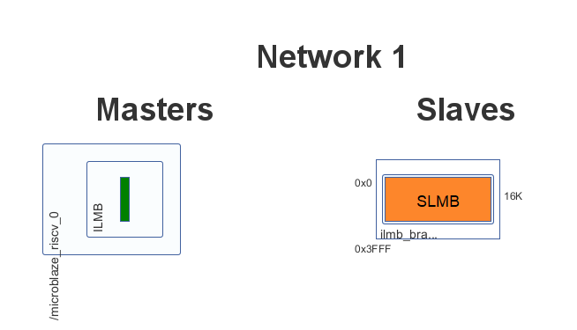
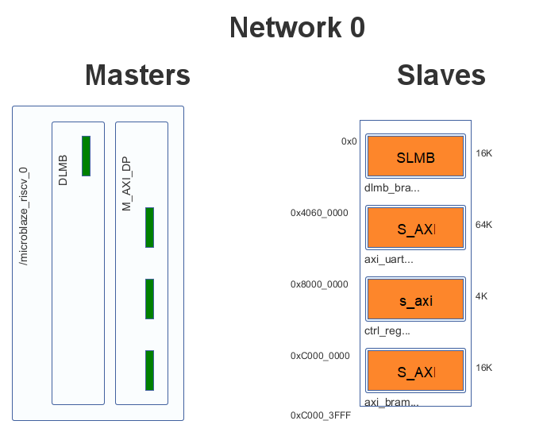
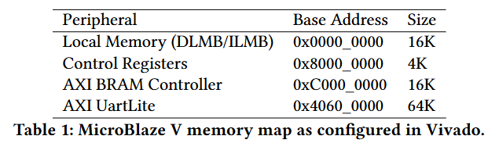
Block View From VIVADO and Memory Mappings

Slide 22
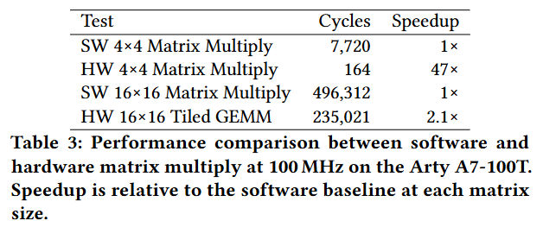
Performance Evaluation
4 Test run on Microblaze on Arty A7 using Vitis and UART
Software 4x4 and 16x16 matrix multiply for baseline
Hardware 4x4 single accelerator call
Hardware 16x16 Tiled GEMM, 64 accelerator calls with partial accumulation in BRAM
Performance measured by rdcycle CSR in Risc V

Slide 23
Discussion & Improvements
47x Speed-Up on 4x4 Single call, 16 parallel outputs generated in parallel vs sequential software
16x16 Speed-Up drops to 2.1x on tiled Hardware Computation (64 Accelerator Calls) vs Software, majority of time spend between communication and data accumulation
Larger Systolic array with wider data types would reduce tiled cost and enable more accurate computation
Multiple Systolic Arrays so multiple sub-blocks can be handled parallely
Interrupt Driven Control Signals vs Polling Driven, so CPU has to use even less resources

Slide 24

Demo using VITIS for single 4x4 Hardware Call

